Slide 1

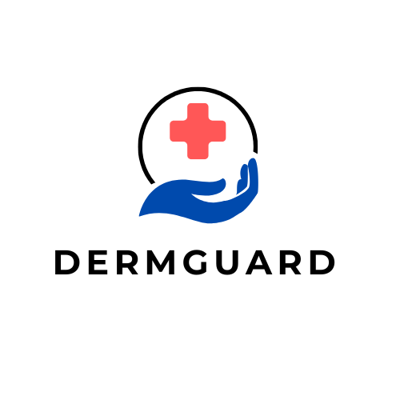
SKIN CANCER DETECTION
WITH MACHINE LEARNING
(DERM GUARD)
Under Supervision of:
Dr. Alaa Zaki
Eng. Rehab Galal

Slide 2
Team Members
Karim Mohsen Mahmoud 2102010
Ziad AbdelWahab Abdelgayed 2101899
Sayed Mohamed Badawy 2101935
Abdalla Yahiya Atalaa 2001514
Mahmoud Mohamed Mahdy 2102068
Hosam Ramadan Abdalla 2101891
Mohamed Salah Darwish 2102045

Slide 3
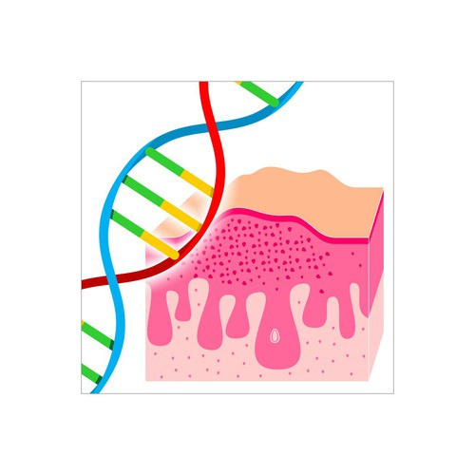
Outline
Machine Learning Methodology
01
Introduction
02
03
Web Application
1.1 Problem: Skin Cancer
1.2 Solution: Machine Learning For Skin Cancer Detection
2.1 Modeling Strategy
2.2 Tools and Libraries
2.3 Data Exploration
2.4 Data Preprocessing
2.5 Model Training
2.6 Saving the models
3.1 Application Idea
3.2 User Interface (UI)
3.3 App Features
04
Backend
3.1 Development with .NET
3.2 Data design and Packages
3.3 Architecture and Design Patterns
3.4 Project Structure

Slide 4
Introduction

Slide 5
Why
kin cancer is one of the most prevalent forms of cancer globally, posing
a significant public health concern. Early detection and classification of
different types of skin cancer are crucial for effective treatment and
patient outcomes. In recent years, deep learning techniques, particularly
Convolutional Neural Networks (CNNs), have shown promising results in
various medical imaging tasks, including skin cancer classification. This
project proposes a comprehensive approach utilizing CNNs for the
automated detection and classification of different types of skin cancer.

Slide 6
Count..
The project involves several key steps. First, we employ a large
dataset comprising diverse images of various skin cancer types,
including melanoma, basal cell carcinoma, and squamous cell
carcinoma. Preprocessing techniques are applied, such as resizing
and oversampling of minority classes. Subsequently

Slide 7
Problem: Skin Cancer
Skin cancer is one of the most common types of cancer that begins with the
uncontrolled reproduction of skin cells. It can occur because of the
ultraviolet radiation from sunshine or tanning beds, and it causes skin cells
to multiply and form malignant tumors. Skin cancer is one of the primary
reasons for deaths worldwide.
According to statistics published by, 2,001,140
Americans were diagnosed with skin cancer in 2024, which is 5.0% of the total
cancer cases reported in the United States, and 611.720 people died because
of skin cancer which is 1.3% of the total deaths because of skin cancer in the
United States.

Slide 8
Count..
Melanoma is one of the most common and dangerous types of skin
cancer that can spread quickly to other body parts. Approximately
21 out of 100,000 melanoma cases were diagnosed in the United
States between 2016 and 2024. The death rate because of melanoma
was 2.1 per 100,000 diagnosed cases, and 1,413,976 people were living
with melanoma in 2024.

Slide 9
Count..
The five-year survival rate of skin melanoma is 93.5% which is relatively
high. The five-year survival rate is 99.6% when skin melanoma is diagnosed
at an early stage. There are more chances of survival when skin melanoma is
localized, which means it does not spread to other body parts, The number of
deaths because of skin melanoma can be reduced if it is detected at its early stages..
The initial step in dermatological diagnosis involves conducting a skin biopsy
to determine whether a skin lesion is malignant or benign. This process, from
securing a dermatologist appointment to receiving biopsy results, typically
spans a week or longer. This project endeavors to shorten this timeline

Slide 10
Solution: Machine Learning for Skin Cancer Diagnosis
Faster Diagnosis: Machine learning expedites the skin cancer diagnostic process.
Enhanced Accuracy: Advanced algorithms analyze large and diverse datasets, improving diagnostic accuracy by identifying subtle patterns that may elude human observation
Improving Access to Healthcare: integration of machine learning tools in skin cancer detection promotes healthcare accessibility by empowering professionals, even in resource-limited settings, to access advanced diagnostic capabilities.

Slide 11
Machine Learning Methodology

Slide 12
Models
Model-1
Dataset
HAM10000, a collection of dermascope skin lesion images. Contains 7 disease classes and about 10000 images.
Architecture
Basic CNN model.
Model-2
Dataset
HAM10000, a collection of dermascope skin lesion images. Contains 7 disease classes and about 10000 images.
Architecture
Pre-trained ResNet Model, and a transfer learning approach.

Slide 13
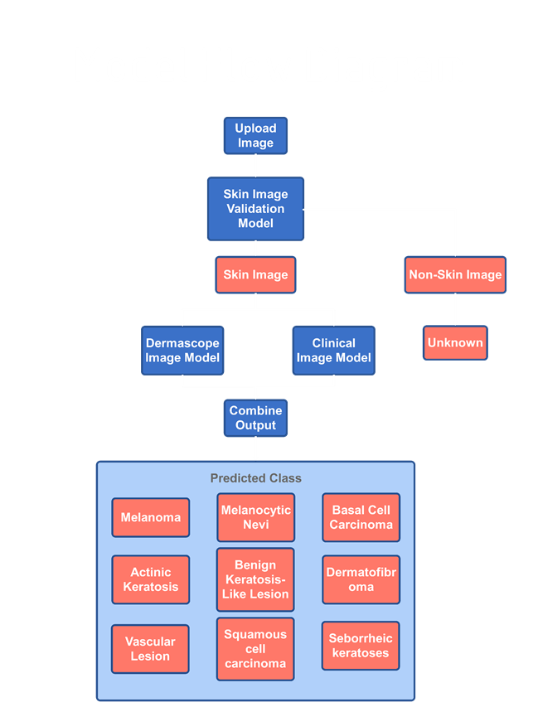
2.1 Modeling Strategy
We used a chain of One deep learning models.
Model (CNN)-: Deals with images coming from a dermascope.
Dermascope image model

Slide 14
Tools and Libraries
NumPy
Pandas
PIllow
Scikit-Learn
TensorFlow
MatPlotLib
Kaggle
Colab

Slide 15
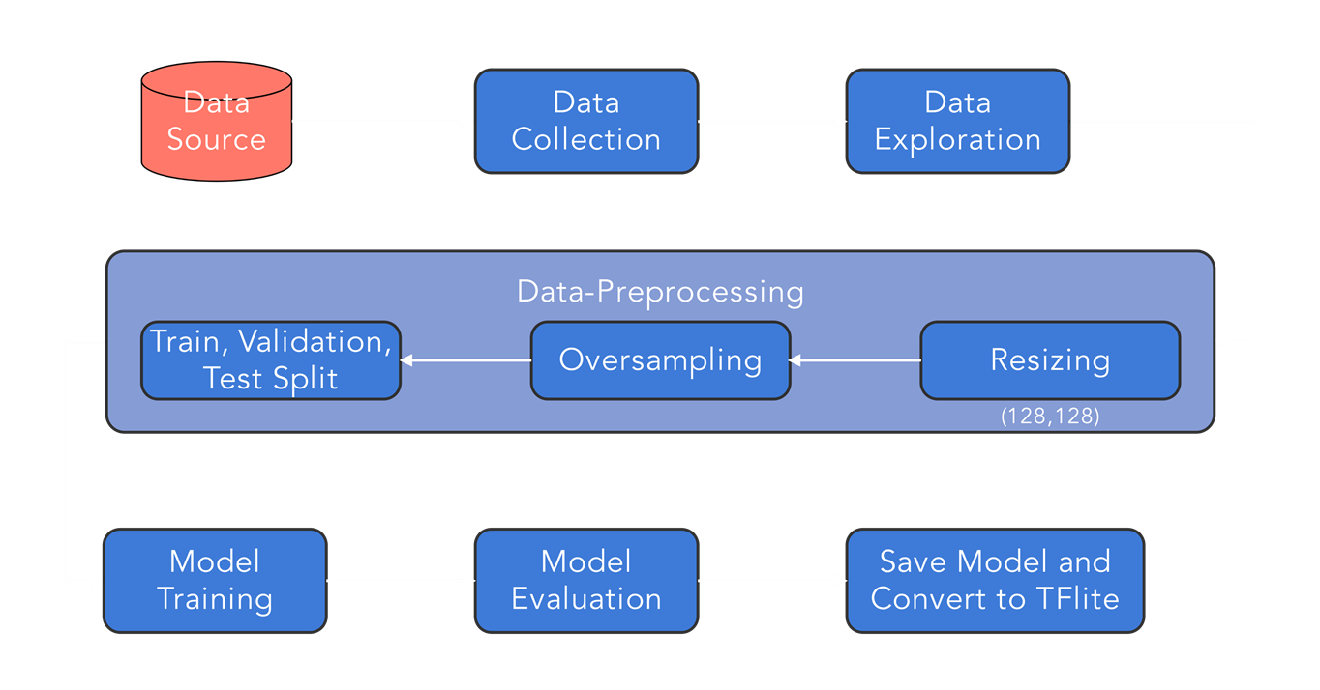
Model Training Pipeline

Slide 16
Data Source
1. Data Source
The dataset used is HAM10000 (Human Against Machine with 10000 training images), a widely recognized and publicly available dataset for skin cancer classification.
Contains 10,015 dermoscopic images of pigmented skin lesions.
Images come in different resolutions and aspect ratios.
All images are labeled and verified manually by certified dermatologists.
There are 7 classes of skin diseases including Melanoma, Melanocytic nevi, etc.

Slide 17
Data Collection
2. Data Collection
Data was collected from multiple reputable sources, including the ISIC Archive.
The dataset includes both image files (.jpg) and a metadata CSV file, which provides:
Diagnosis (lesion type)
Patient info (age, sex)
Location on the body

Slide 18
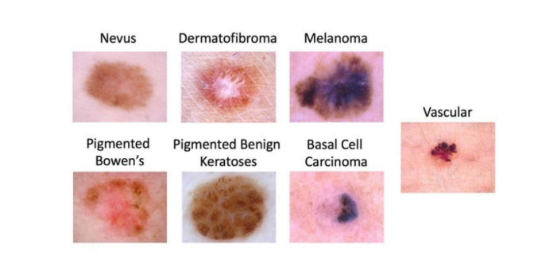
7 classes

Slide 19
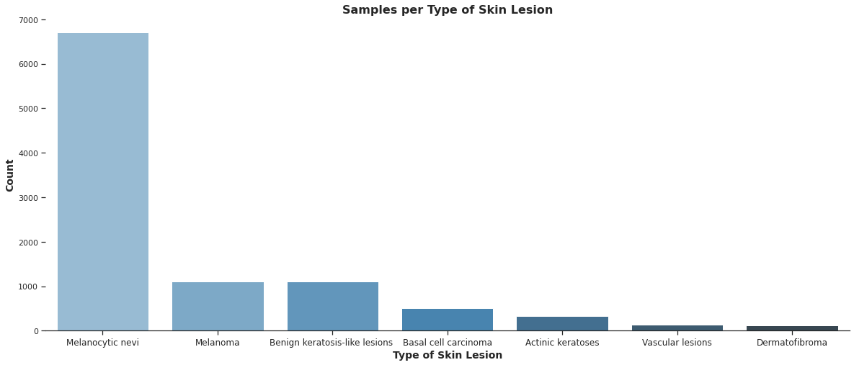
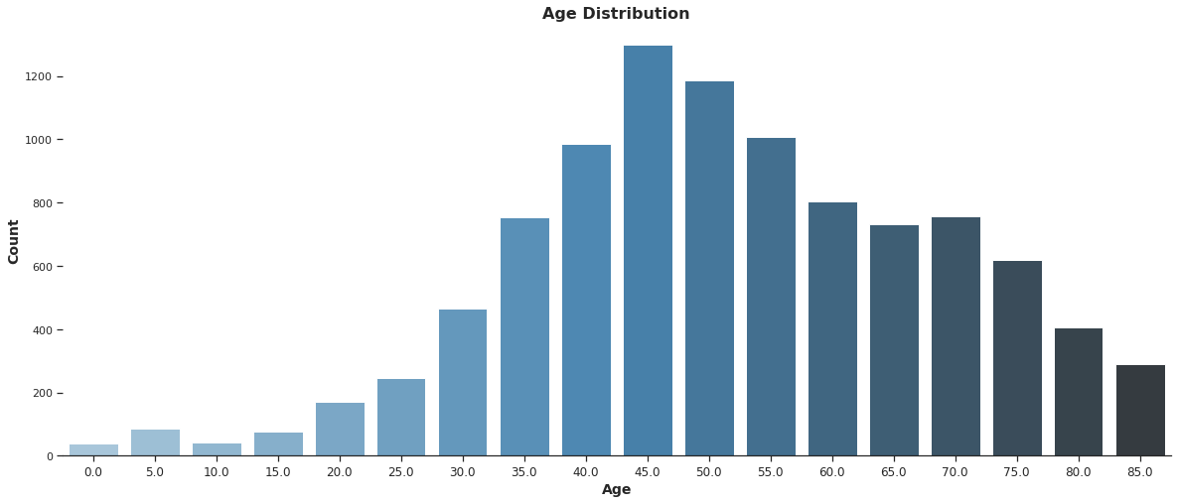
Exploratory Data Analysis
We used python and matplotlib to analyze the HAM1000 dataset.
Melanocytic nevi is the dominant class in the dataset (67%). This could result in a bias in classification towards this type of skin lesion.
The samples are predominantly from patients within 40 - 55 years old. Probably because skin cancer is more common in older people.
Notes:
عشان نExplore الداتا و نعمل Visualization استخدمنا بايثون و مكتبة matplotlib
في الجراف دا هنلاقى الdistribution للclasses في الداتاسيت، فهنلاحظ ان في كلاس واحد اللى هو الMelanocytic Nevi هو الغالب في الداتاسيت حوالى 67% و دا ممكن يسبب مشكلة لما نيجى ندرب الموديل لأنه ممكن يخلى الموديل ينحاز في الclassfication للclass دا عن باقى الclasses ، يعنى مش هيقدر يصنف الminority classes بaccuracy عالية زى الclass الغالب، و دى مشكلة لازم نحلها قبل ما ندرب المودل

Slide 20
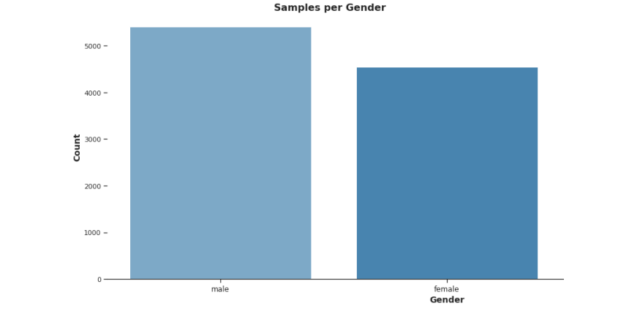
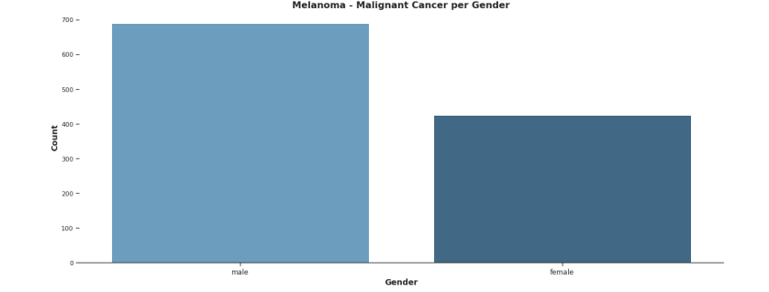
Data exploration
There’s a 55/45 split between genders.
This matches industry established
Distribution.
There is a 60/40 split in the Malignant
population for males and females due to
the fact that under 50, melanoma occurs
more frequently in women, while above
50, occurs more often in men and increasingly
so moving into 80

Slide 21
Data Pre-processing
Because of the imbalance in the dataset, we oversampled the minority classes so they’re equal in size.
Steps
Splitting the data into train, validation, and test data
64% Training
16% Validation
20% Test
Resizing images to 28 x 28
Original images in the datasets are of a large size. For instance, The images in the HAM10000 dataset are of dimension (450 x 600 x 3). This will have a huge computational time while training. Therefore we resize the images to be of size (28 x 28 x 3) for all of the datasets used.
Notes:
1- oversampling
2- resizing 128x128
3- data augmentation
4- normalization
5- train, validation, tet split
6- saved to folders with class names

Slide 22
Data pre processing
3. Data Oversampling :
Deep neural networks perform better with large amounts of data with a distribution that matches the test data. First, we use data Oversampling to deal with the class imbalance in the datasets. This is done by making multiple copies of the images in the minority classes so that in the end, all classes contain an equal number of images.
4.Data augmentation: aims to create images that depict the features of its class in every possible angle, such that, at whatever angle the image may be taken, our trained model can predict it with more precision. We use a data augmentation layer at the beginning of all our models.

Slide 23
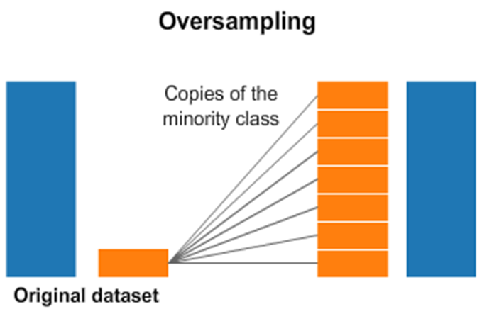
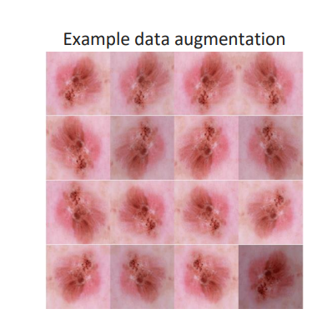
Different techniques used for this are:
1. Randomly rotate the images in the range from 0 to 180 degrees
2. Randomly zoom images
3. Randomly flip images horizontally
4. Randomly flip images vertically
5. Randomly shift the images horizontally
6. Randomly shift the images vertically

Slide 24
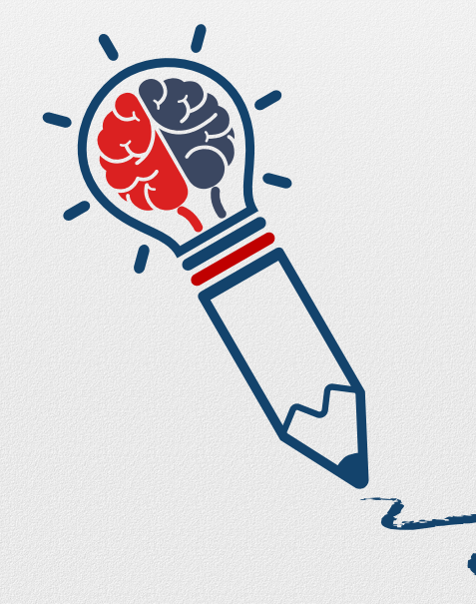
Limitation of previous work
Data set imbalance
Low quality images
Similarities between types of cancer

Slide 25
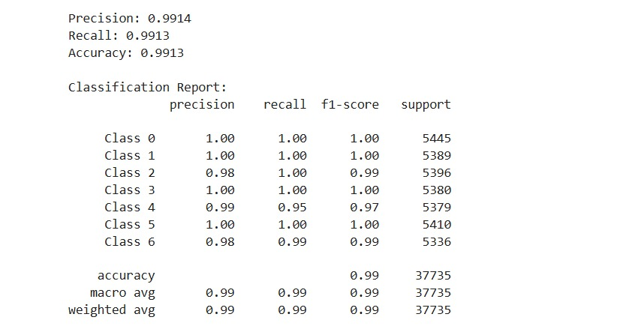
Model Training The model used is a Convolutional Neural Network (CNN). All models were trained for 20 epochs.

Slide 26
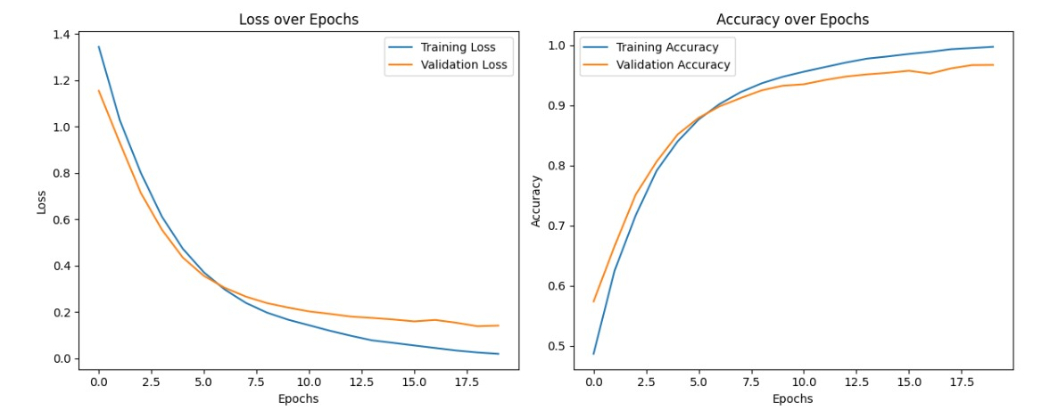
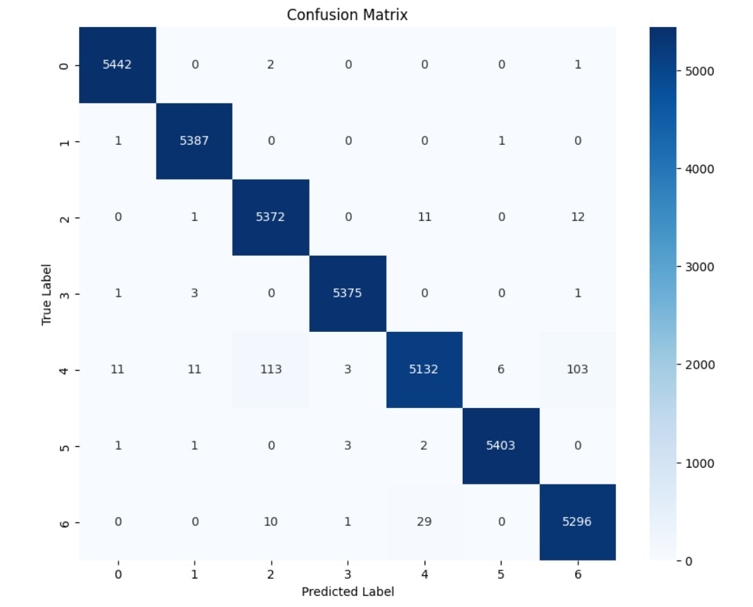
Training Results
Model-1: CNN 99% training accuracy, and a 96% test accuracy.
Model-2: ResNet101 95% training accuracy and a 93% test accuracy.

Slide 27
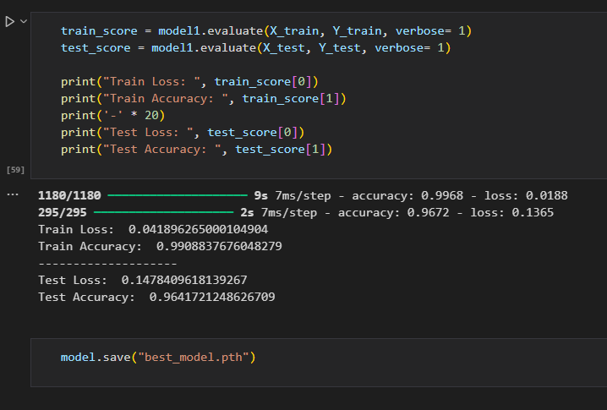
8. Save the Model

Slide 28
Web Application

Slide 29
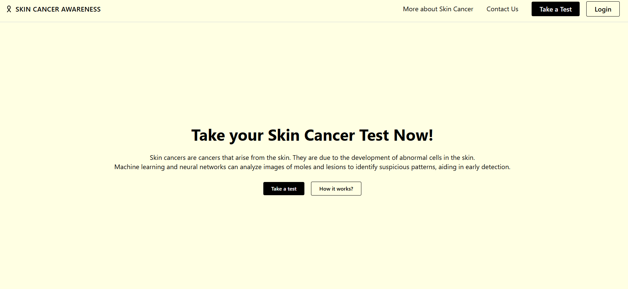
Application Idea
App was designed to aid in the detection and classification of skin cancer.
It serves two main user groups; patients or doctors.
Using AI technology, the app analyzes skin images to detect and classify skin cancer, providing a comprehensive solution for both diagnosis and management.
Notes:
طيب ليه بنفكر نستخدم الMachine Learning لتشخيص سرطان الجلد؟
أولا التشخيص أسرع، الMachine Learning بيسرع عملية التشخيص بدل من الbiopsy و دا معناه بدأ العلاج في الوقت المناسب و بالتالى نتايج أفضل للمرضى
Enhanced Accuracy ، الMachine Learning يقدر يزود دقة التشخيص عن طريق تحديد patterns ممكن متبانش بالملاحظة البشرية، و بالتالى بيقلل احتمالية الfalse negatives و الfalse positives
كمان استخدام الmachine learning بيتيح إمكانية الوصول لأدوات أفضل للتشخيص في الأماكن قليلة الموارد

Slide 30

User Interface (UI)
We used Figma as an environment to build the app UI.
Tools used are plugins: Iconify, Unsplash, Ui faces and a little mockup.
Tools in Figma that aided the design process:
Components: streamlines edits by allowing changes to propagate throughout the design.
Auto Layouts: Automatically organize elements without additional adjustments.
Notes:
الخطوة اللى بعد كدا هي الData pre-processing و زى ما قلنا عشان فيه Class imbalance، ان class واحد واخد 67% من الداتا، فعملنا oversampling للminority classes بمعنى اننا خدنا الclasses الأصغر و كررنا الصور اللى فيها بحيث كل الclasses يبقى فيهم نفس عدد الصور و دا ادانا 46000 صورة في الأخر
قبل الoversampling عملنا train, validation, test split للداتا اللى هي خطوة أساسية في أي مشروع machine learning قبل تدريب المودل، فبنستخدم الtraining data في عمل training للمودل و الvalidation عشان نتأكد ان الaccuracy بتاعت المودل على الtraining set مشابهة للaccuracy على data براها، يعنى عشان نتأكد ان المودل معملش overfitting على الtraining data
بعد كدا عملنا resize و سيفنا الصور في فولددرز لكل كلاس

Slide 31
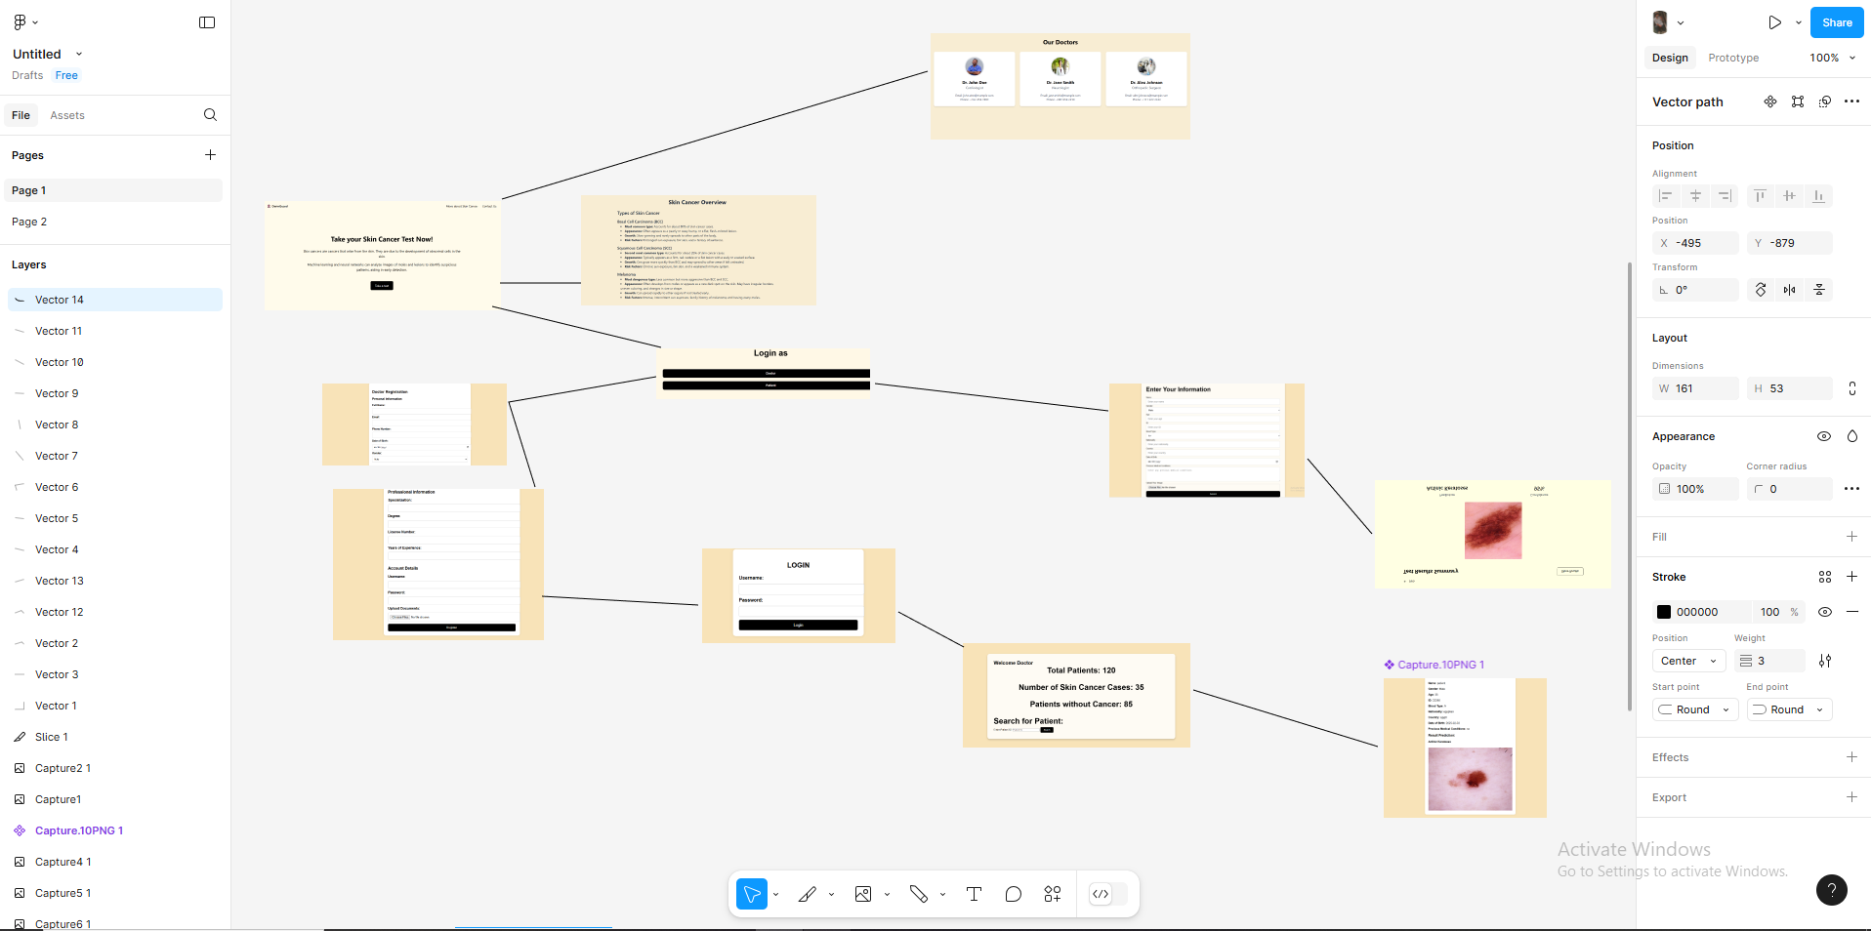
User Interface (UI)
Prototyping
A prototype is an initial model developed to meet key requirements.
Early modeling saves time and costs by identifying usability issues early, improving designs before production begins.
Notes:
الخطوة اللى بعد كدا هي الData pre-processing و زى ما قلنا عشان فيه Class imbalance، ان class واحد واخد 67% من الداتا، فعملنا oversampling للminority classes بمعنى اننا خدنا الclasses الأصغر و كررنا الصور اللى فيها بحيث كل الclasses يبقى فيهم نفس عدد الصور و دا ادانا 46000 صورة في الأخر
قبل الoversampling عملنا train, validation, test split للداتا اللى هي خطوة أساسية في أي مشروع machine learning قبل تدريب المودل، فبنستخدم الtraining data في عمل training للمودل و الvalidation عشان نتأكد ان الaccuracy بتاعت المودل على الtraining set مشابهة للaccuracy على data براها، يعنى عشان نتأكد ان المودل معملش overfitting على الtraining data
بعد كدا عملنا resize و سيفنا الصور في فولددرز لكل كلاس

Slide 32
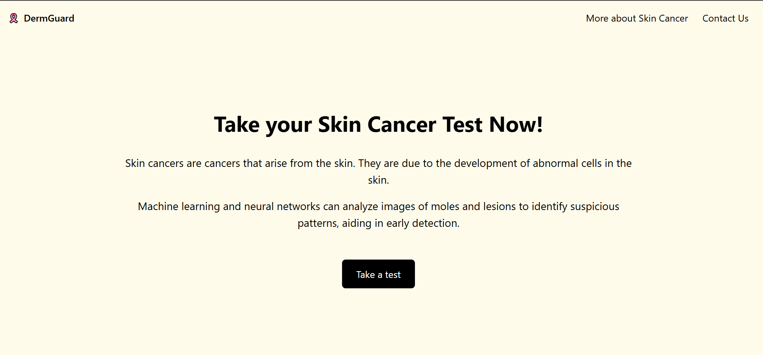
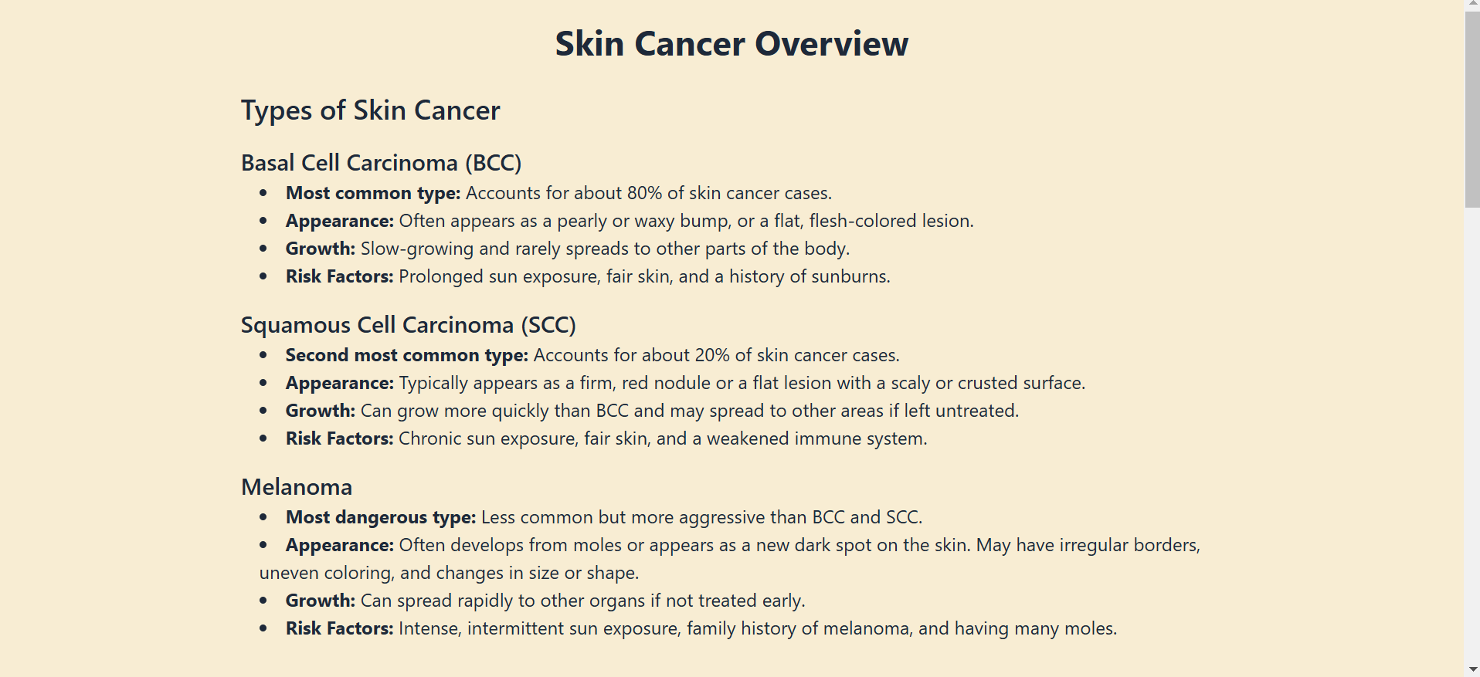
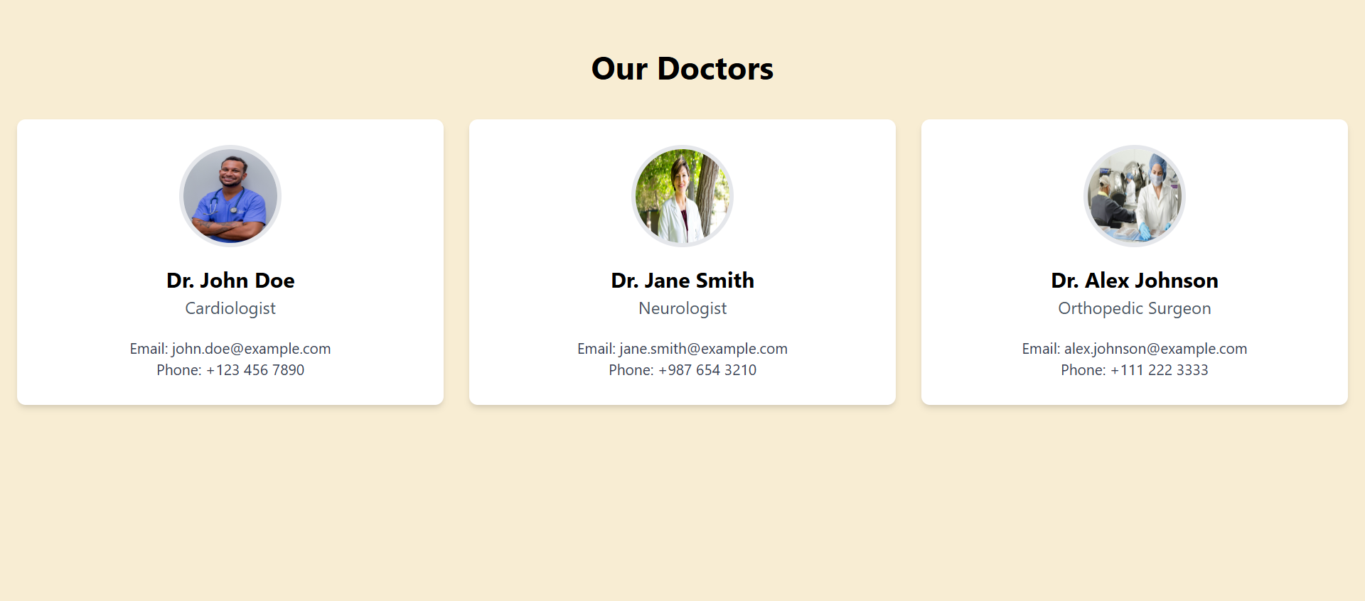
Features
Overview
The first page of the program gives an idea of ​​what skin cancer is and what the idea of ​​our project is
More about skin cancer
It gives an idea about skin cancer, what the disease is, and what are all its types and symptoms. The first cases of the disease being discovered
Contact us
Here we know who the doctors are with us on the program and ways to communicate with them

Slide 33
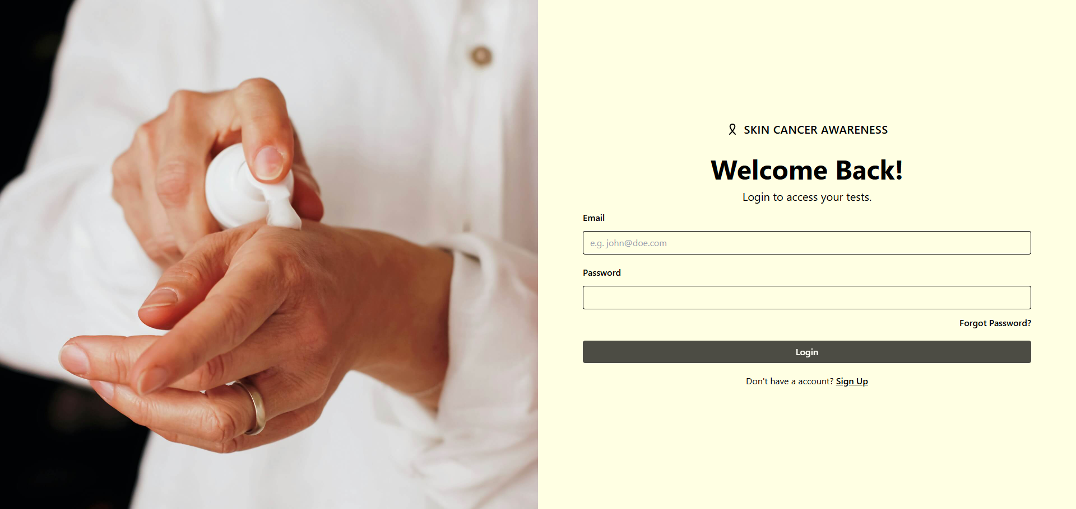
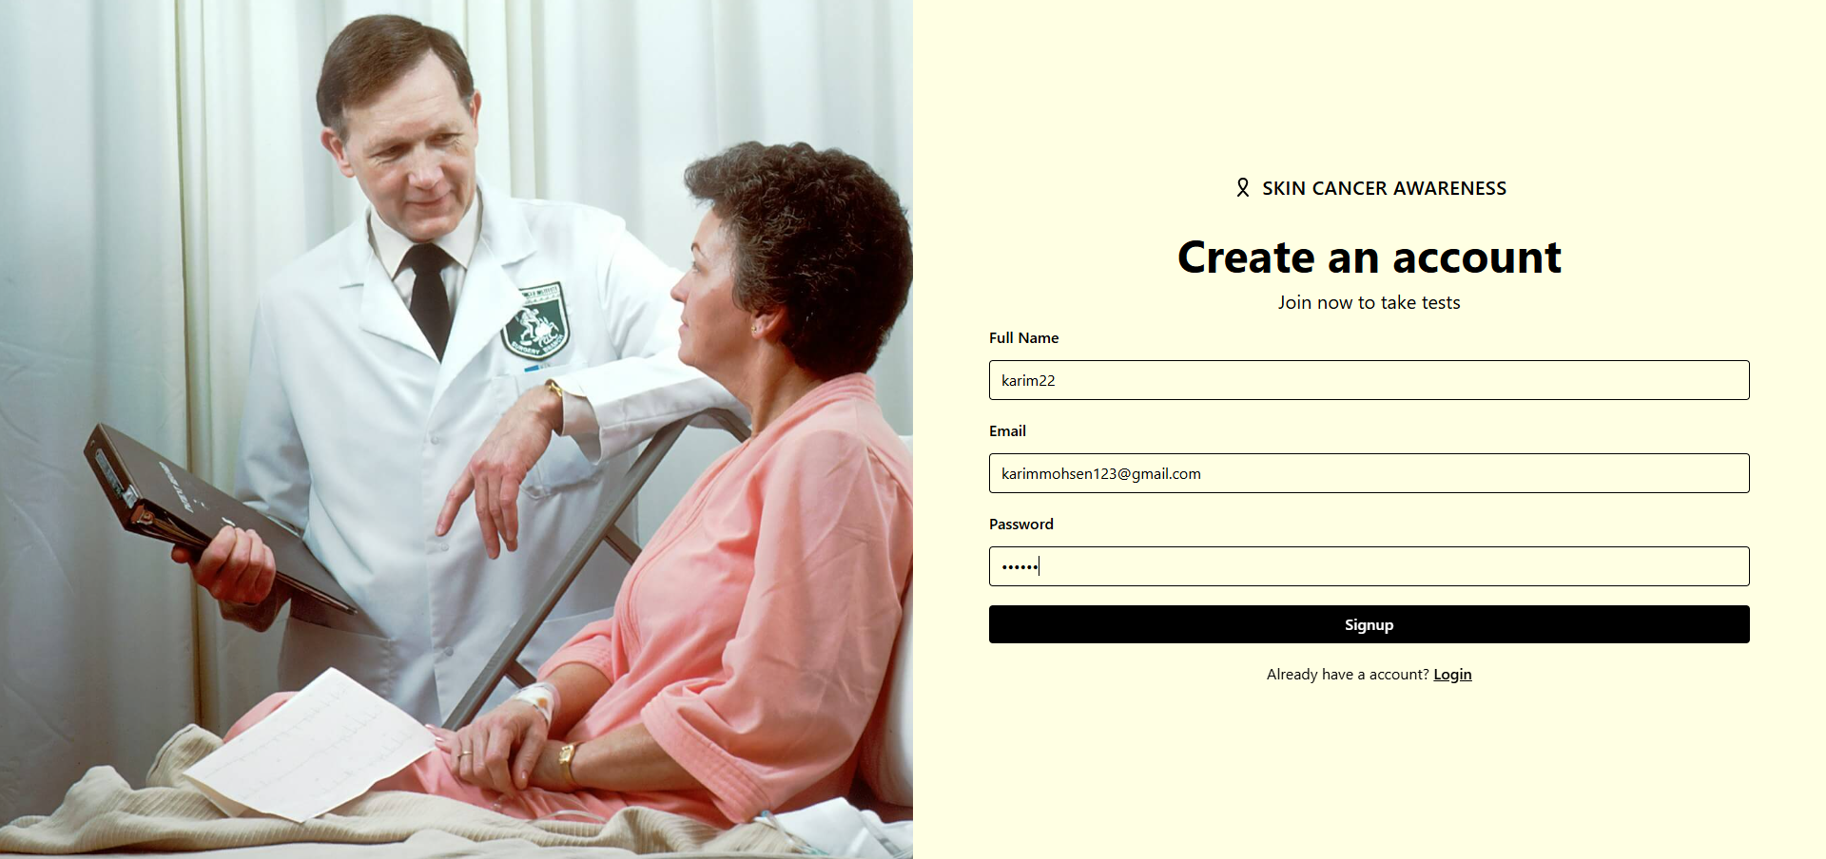
Features
First, you must login before taking any test with a picture. If you do not have an account, you can sign up
Notes:
طيب ليه بنفكر نستخدم الMachine Learning لتشخيص سرطان الجلد؟
أولا التشخيص أسرع، الMachine Learning بيسرع عملية التشخيص بدل من الbiopsy و دا معناه بدأ العلاج في الوقت المناسب و بالتالى نتايج أفضل للمرضى
Enhanced Accuracy ، الMachine Learning يقدر يزود دقة التشخيص عن طريق تحديد patterns ممكن متبانش بالملاحظة البشرية، و بالتالى بيقلل احتمالية الfalse negatives و الfalse positives
كمان استخدام الmachine learning بيتيح إمكانية الوصول لأدوات أفضل للتشخيص في الأماكن قليلة الموارد

Slide 34
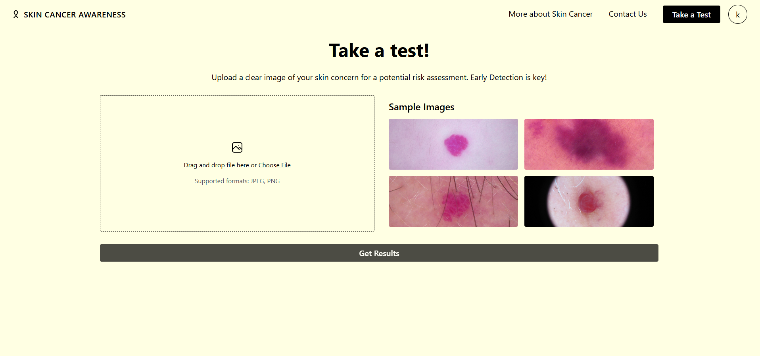
Doctor or Patient Features
AI Image Register and Testing
Here, after clicking on “Take a test,” I will see upload skin photos to the application.
An AI model analyzes the image to detect the presence of skin cancer. If skin cancer is detected, the AI ​​classifies the type of skin cancer.
Notes:
طيب ليه بنفكر نستخدم الMachine Learning لتشخيص سرطان الجلد؟
أولا التشخيص أسرع، الMachine Learning بيسرع عملية التشخيص بدل من الbiopsy و دا معناه بدأ العلاج في الوقت المناسب و بالتالى نتايج أفضل للمرضى
Enhanced Accuracy ، الMachine Learning يقدر يزود دقة التشخيص عن طريق تحديد patterns ممكن متبانش بالملاحظة البشرية، و بالتالى بيقلل احتمالية الfalse negatives و الfalse positives
كمان استخدام الmachine learning بيتيح إمكانية الوصول لأدوات أفضل للتشخيص في الأماكن قليلة الموارد

Slide 35
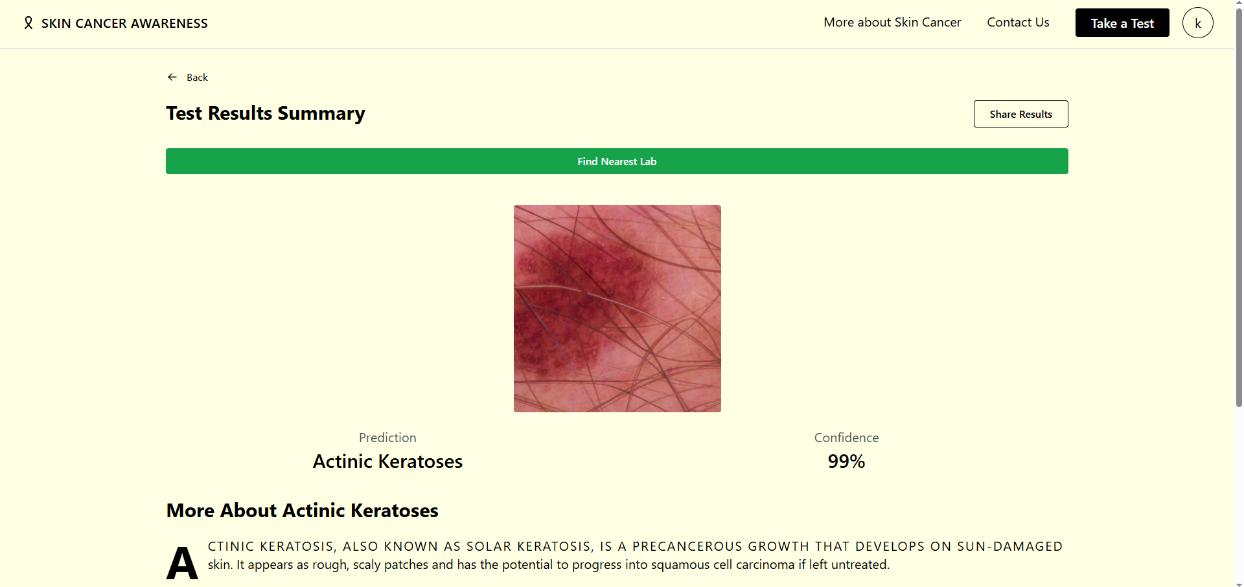
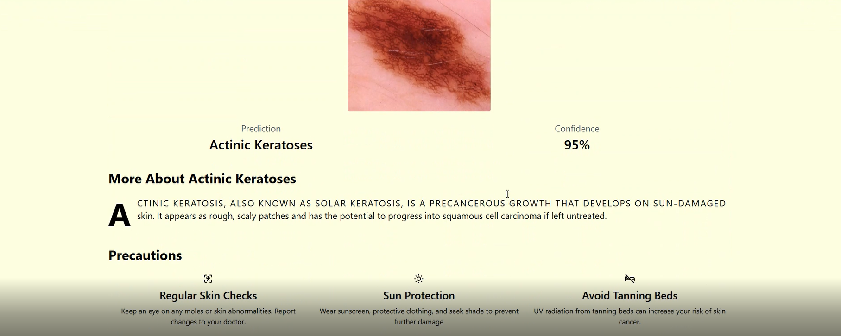
Result

Slide 36
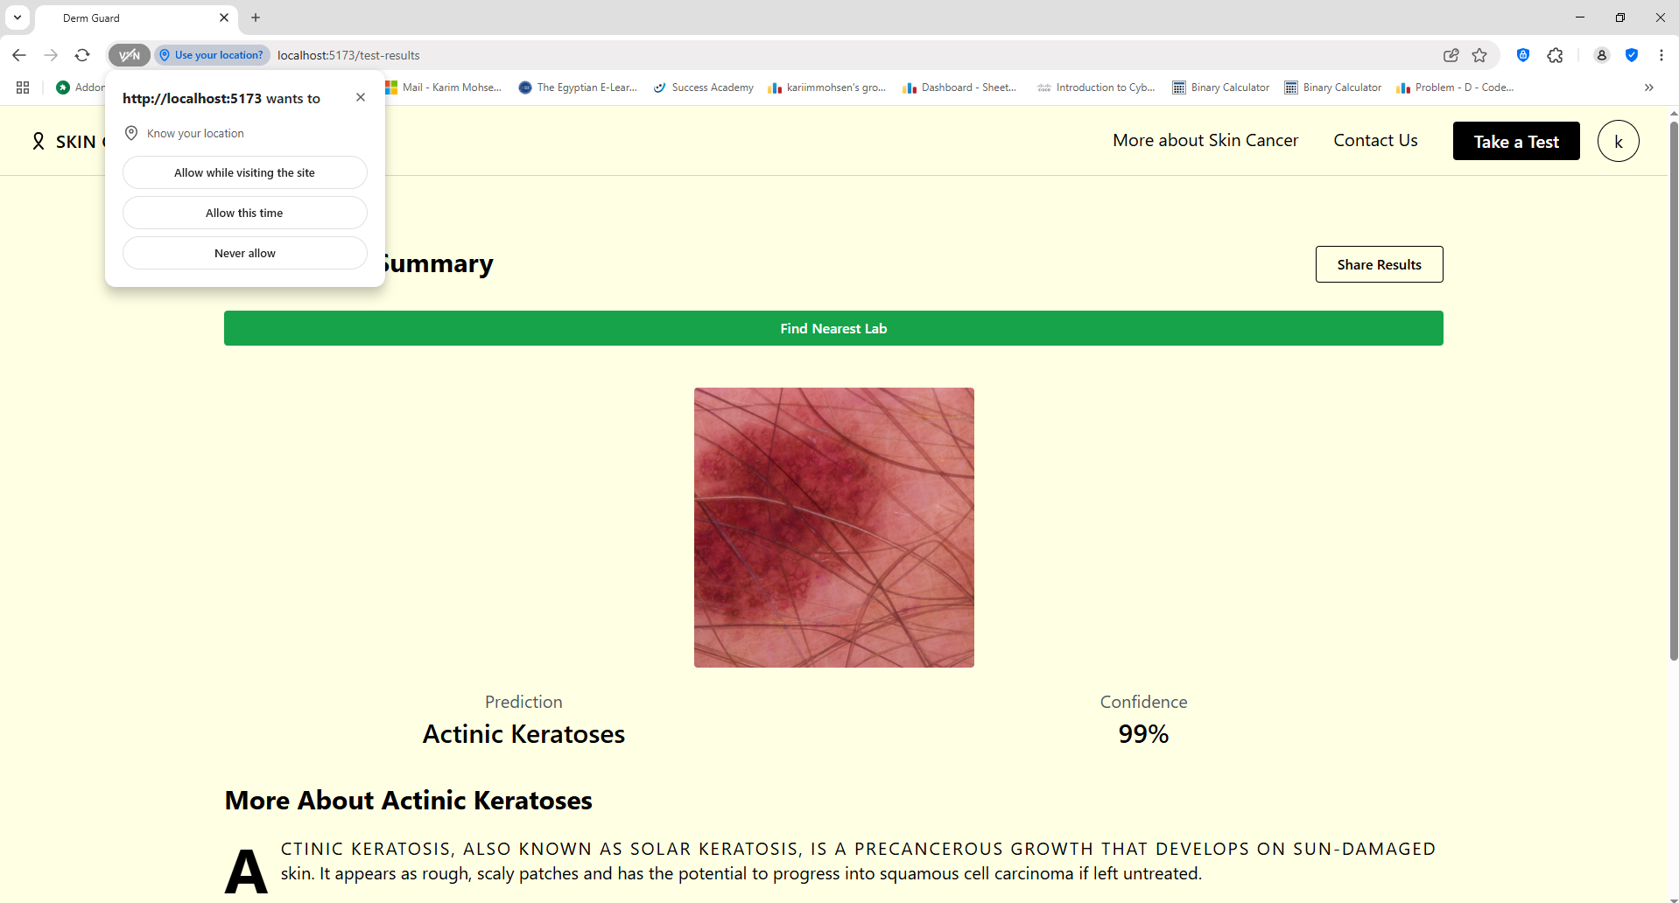
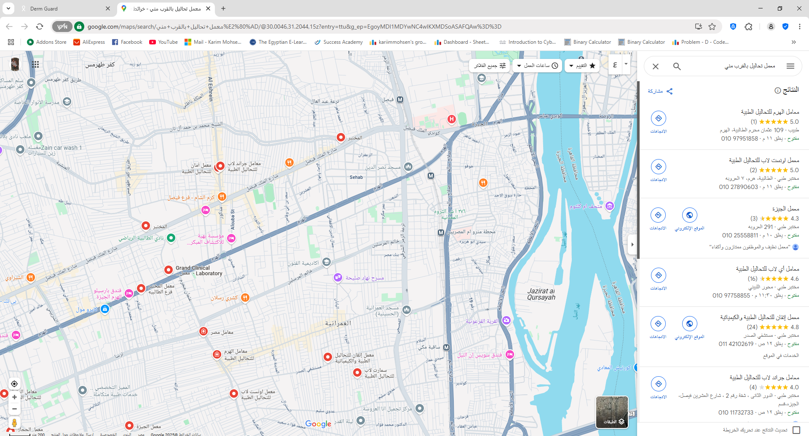
Features
Nearst Medical Labs :
When you click on this feature, you can search for all near labs you based on your current location.
Notes:
طيب ليه بنفكر نستخدم الMachine Learning لتشخيص سرطان الجلد؟
أولا التشخيص أسرع، الMachine Learning بيسرع عملية التشخيص بدل من الbiopsy و دا معناه بدأ العلاج في الوقت المناسب و بالتالى نتايج أفضل للمرضى
Enhanced Accuracy ، الMachine Learning يقدر يزود دقة التشخيص عن طريق تحديد patterns ممكن متبانش بالملاحظة البشرية، و بالتالى بيقلل احتمالية الfalse negatives و الfalse positives
كمان استخدام الmachine learning بيتيح إمكانية الوصول لأدوات أفضل للتشخيص في الأماكن قليلة الموارد

Slide 37
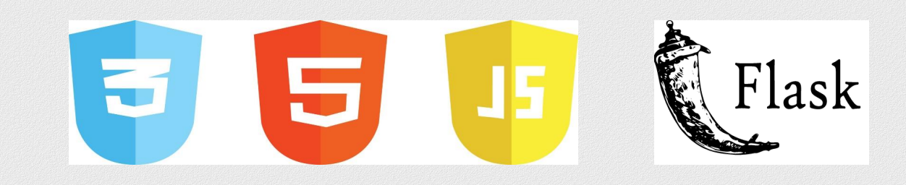
Technologies used in deployment
Flask
HTML
CSS
JavaScript
Tailwind CSS
Mongo DB
React

Slide 38
Backend

Slide 39
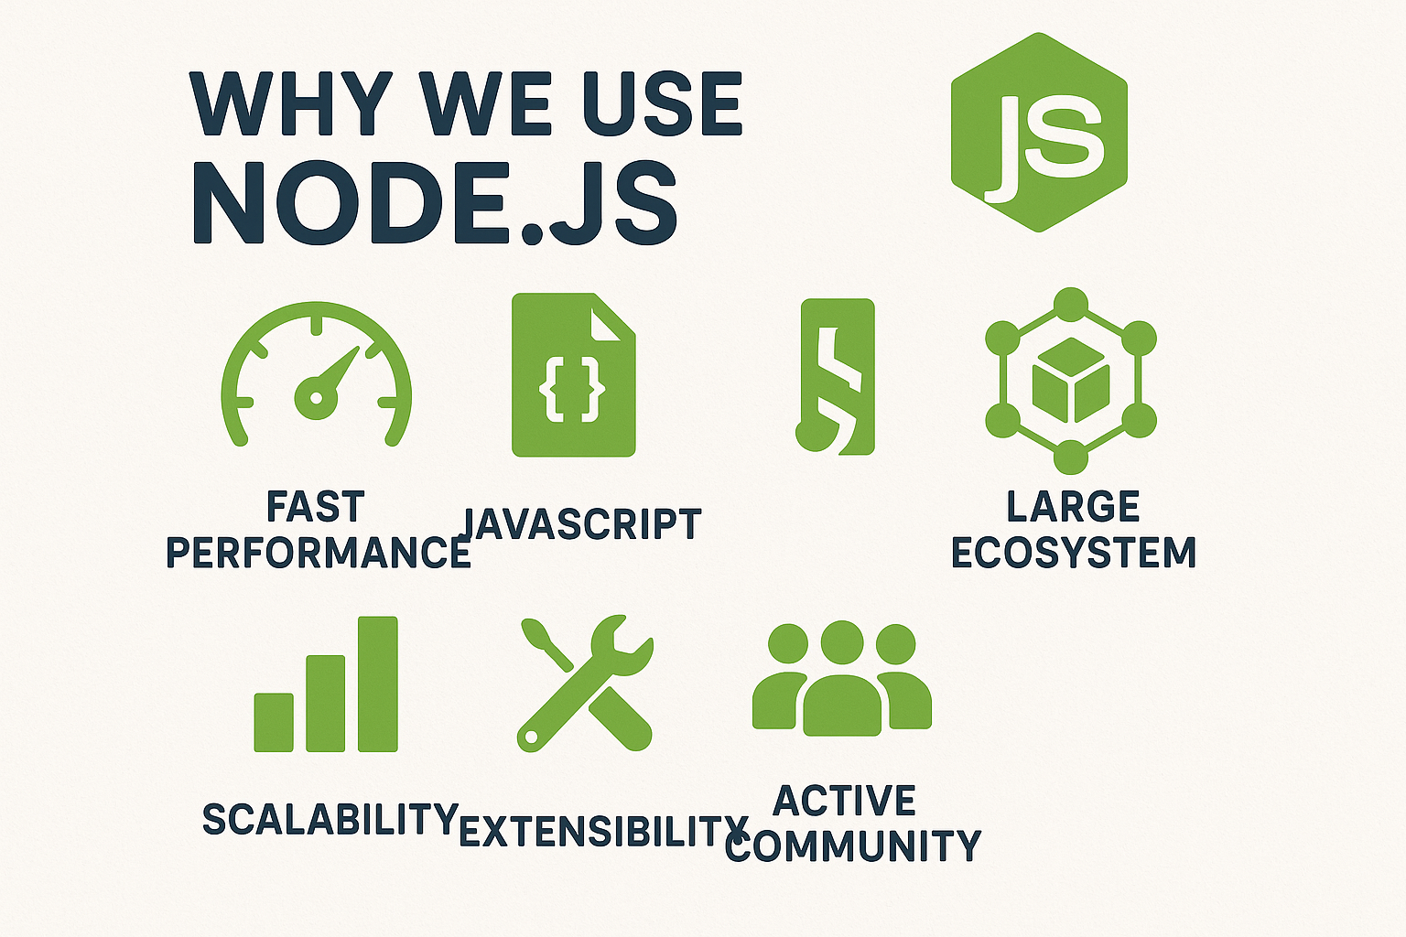
Backend development with Node JS
We Used the Node JS framework to develop our Backed.

Slide 40
Node JS Packages Used
For the project we used several Node JS packages to enhance the backend functionality and performance.
Express
Node Js Web FrameWork.
Mongo DB
Acts as the primary database for storing and managing data.
Provides robust data storage, complex query support, and ensures data integrity.
Cros
Enable Cors For Front-end and Back-end Communication.
JwtBearer (JSON Web Token Bearer)
Implements authentication and authorization.
Secures access to application features and protects user information.
Axios
Used For Model Integration And Internal Request.

Slide 41
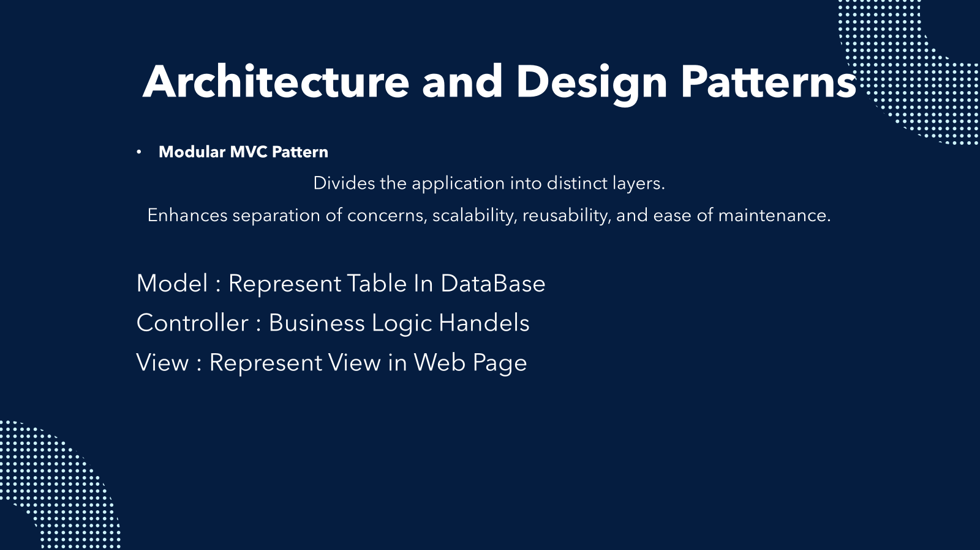
Thank You ✨

Slide 42

Architecture and Design Patterns
Service Layer
Encapsulate Business Logic or External Intreactions , Handel HTTP Request.
Singleton Pattern(Implied in db connections (js)
Ensures Only Instance of The MongoDB Connection Is Used across The App.

Slide 43
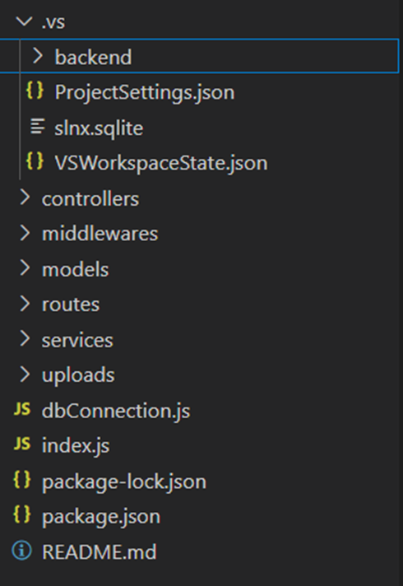
Project Structure
Skin cancer Backend layers:

Slide 44

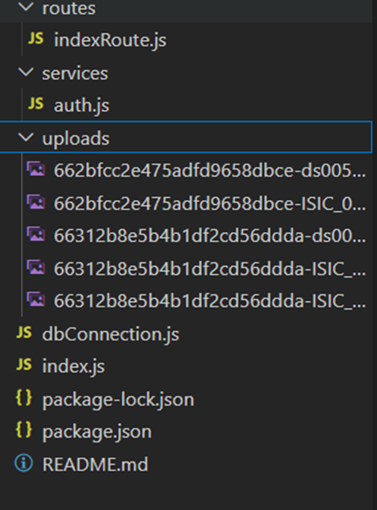
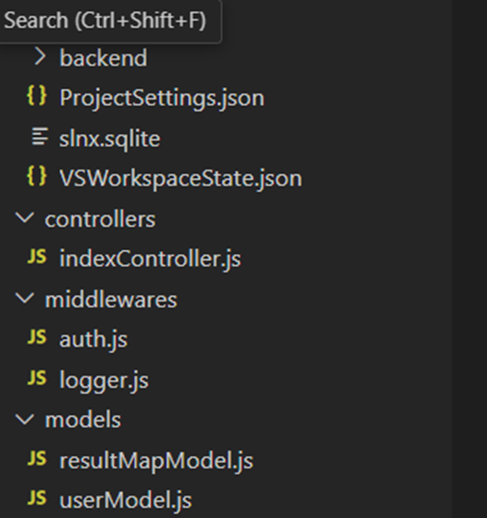
Project Structure
SkinCancer.Api
The main entry point of the application.

Slide 45
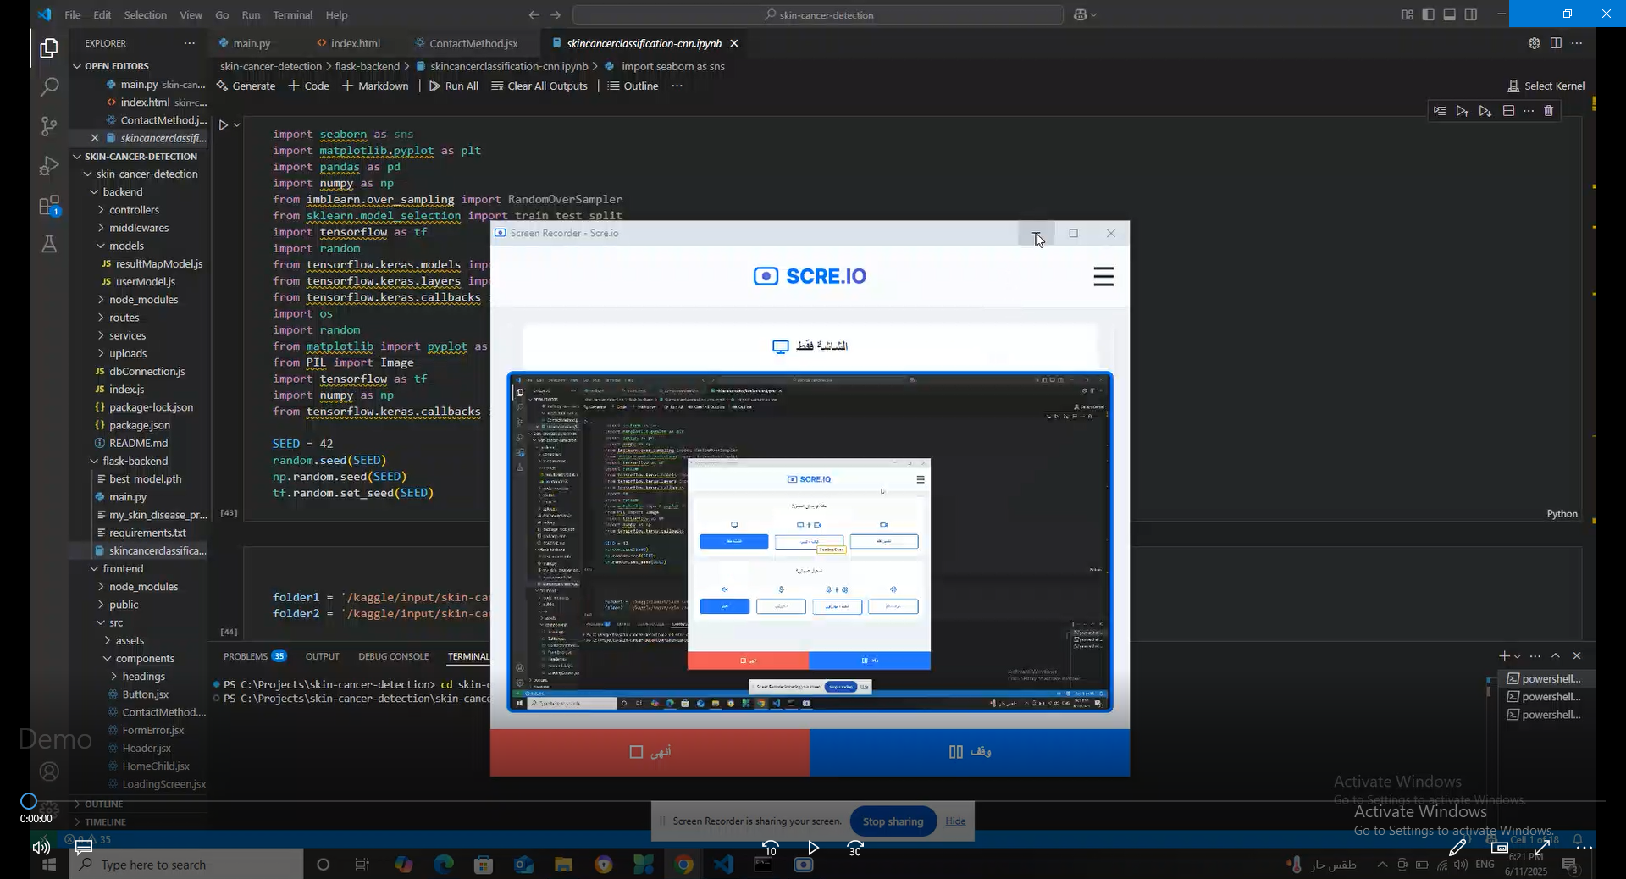
Demo of our website

Slide 46
Conclusion
In this project we have demonstrated the application of deep learning techniques, specifically Convolutional Neural Networks for the detection and classification of skin cancer.
Our project underscores the importance of early detection in the treatment of skin cancer and highlights the potential of AI-driven solutions in medical diagnostics.

Slide 47
References
https://www.mdpi.com/2227-9032/10/12/2481
https://www.iarc.who.int/cancer-type/skin-cancer/
https://www.figma.com/
https://www.ncbi.nlm.nih.gov/books/NBK441949/
https://www.kaggle.com/datasets/kmader/skin-cancer-mnist-ham10000

Slide 48
Thank You ✨

